Slide 1
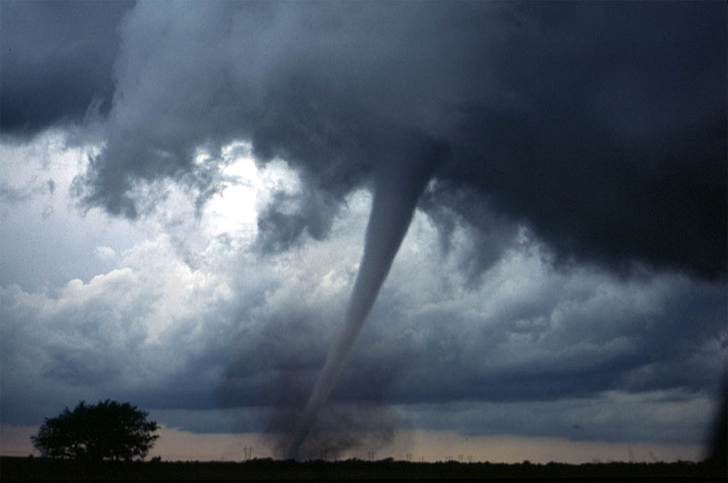
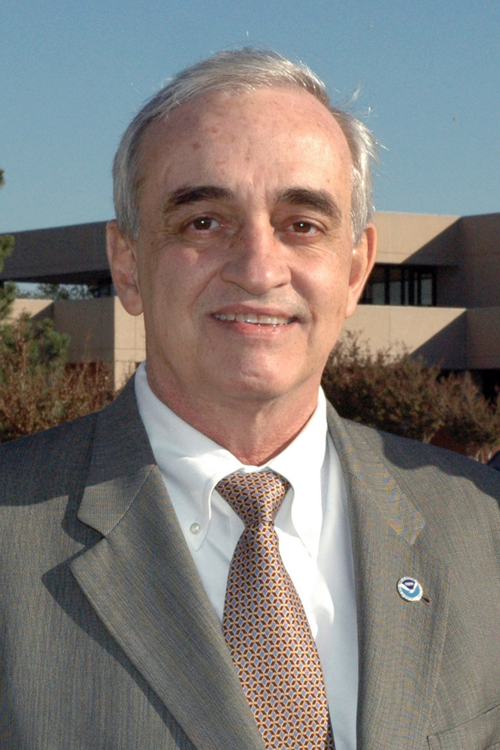
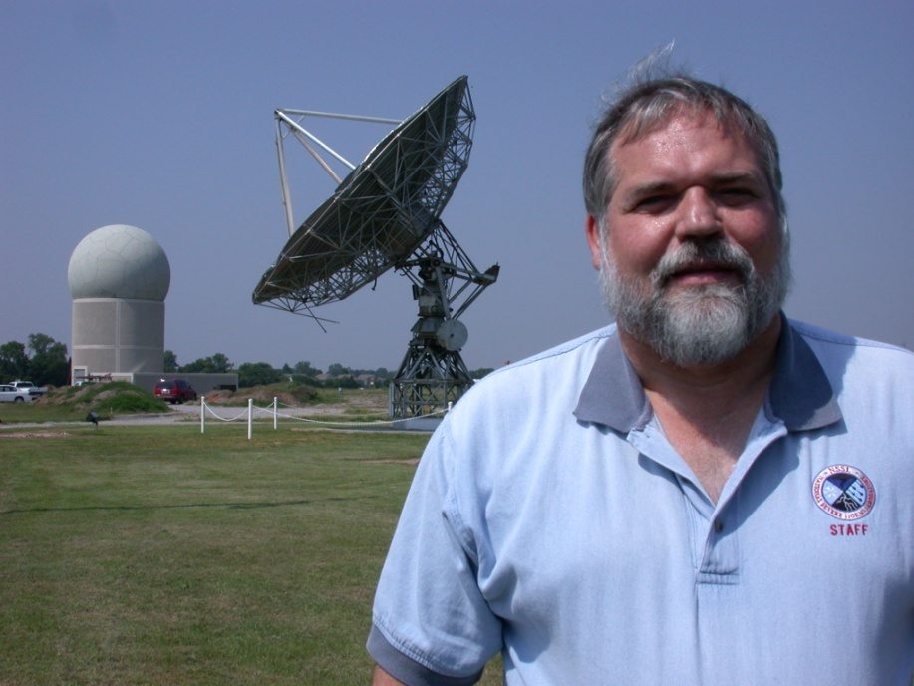

Looking to the Future
Radar Research
Presentation For
The Kimpel Symposium
Douglas Forsyth
Executive Director for Facilities and Strategic Planning
and
Chief, Radar Research & Development Division
June 2010

Slide 2
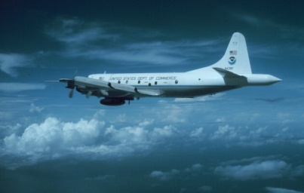
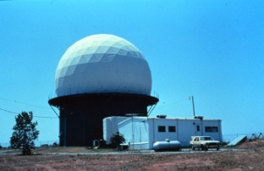
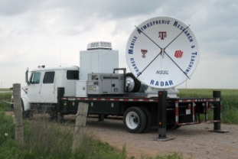
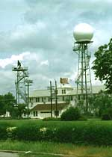
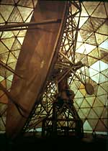
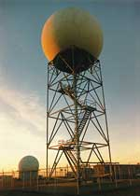
NSSL RADAR HISTORY
First PPP for NOAA P-3
1980
First Dual Doppler using P3 & Cimarrron
1989
Helped build First DOWs
1995
Cimarron Upgraded
Dual-Polarization
83-84
First Dual
Doppler
Analysis
1974
First Dual-polarization Real Time
Displays
1992
First WSR-88D Research Radar
1996
First Dual-polarization Time Series
1984
Cimarron
10cm
Doppler
1973
First Calculations of
Differential Phase &
Cross Correlation Coefficient
Initial Algorithm Development
Mesocyclone
Wind Profiling
81-86
Norman
10cm
Doppler
1971
JDOP
77-79
First WSR-88D
Installed
1989
WDSS
WSR-57
Research
1960s
1970
1973
1980
1984
2000
1971
1990
1974

Slide 3
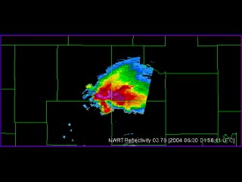
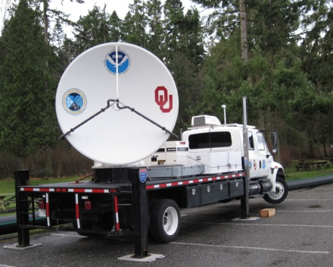


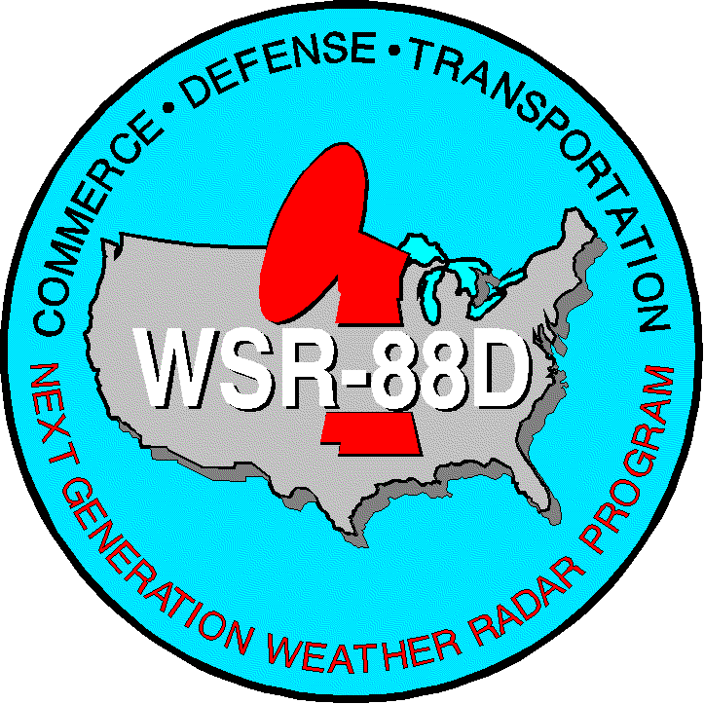
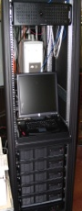

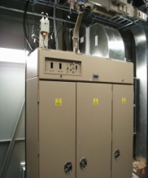
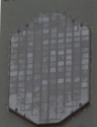
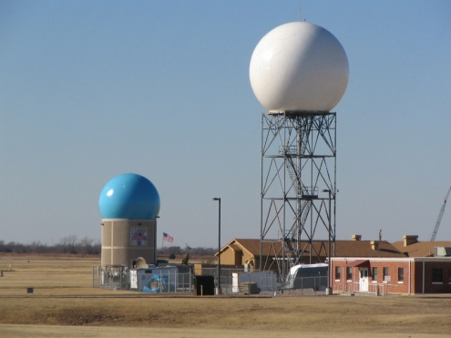
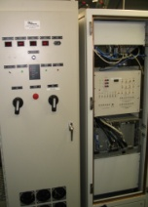

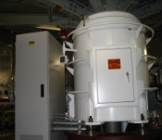
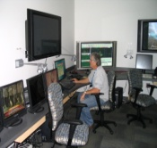
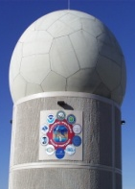
NSSL RADAR HISTORY
)
RRDA
1st PAR data
Initialize Model
OPUP
WDSS-II
ORPG
1st Tornado
With PAR
ORDA
Dual Polarization
NWRT
Operational
2000
2001
2002
2003
2004
2005
2006
2007
2008
2009

Slide 4
What’s in the near Future
Fleet of Dual Polarized S-Band Radars
Real-time initialization of Storm Scale Models
Real-time 4-D virtual radar data bases
Access and combining of various types of radar systems (different freq, different resolutions, etc)
Decrease in Volumetric data collection times (Faster Volume Scans)
Improved understanding of thunderstorm evolution as seen by radar

Slide 5
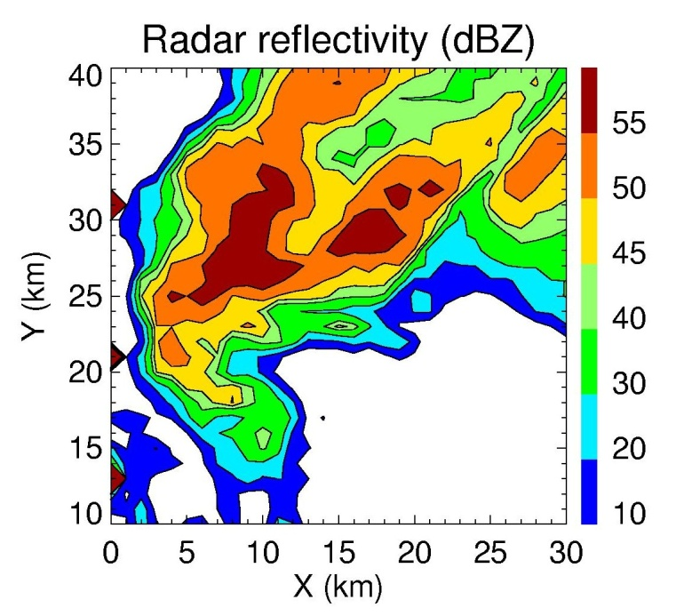
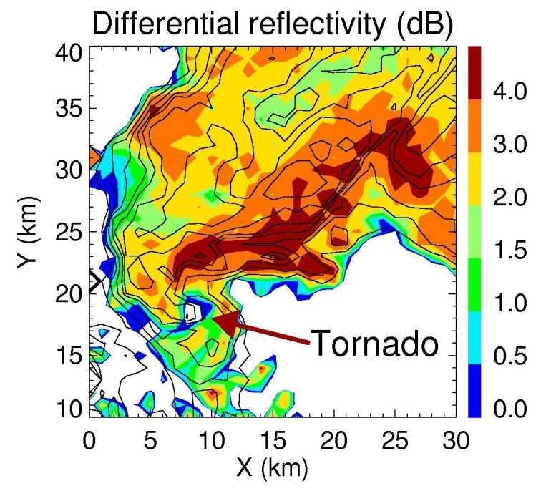
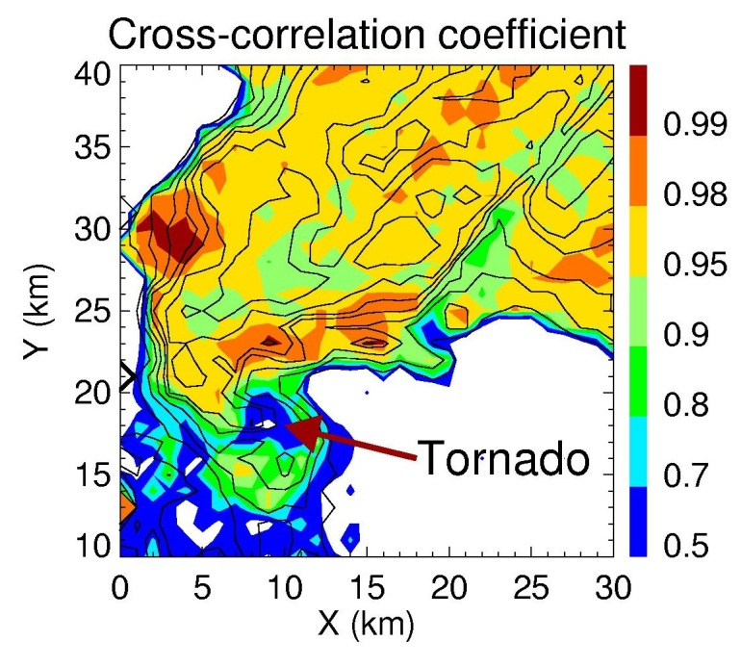
Polarimetric Tornado Detection
Oklahoma City tornado on 8 May 2003
Tornadic debris has distinct polarimetric signature

Slide 6
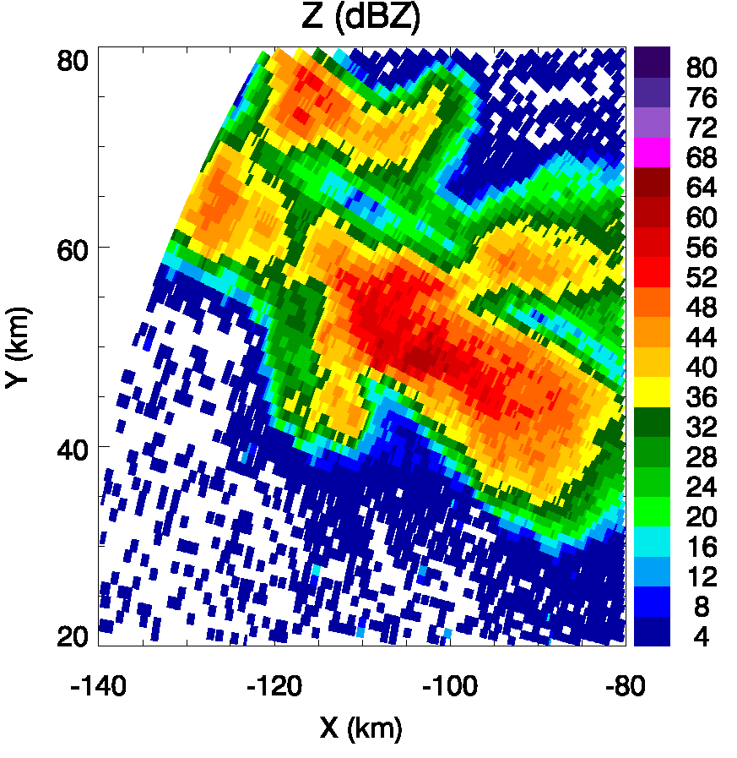
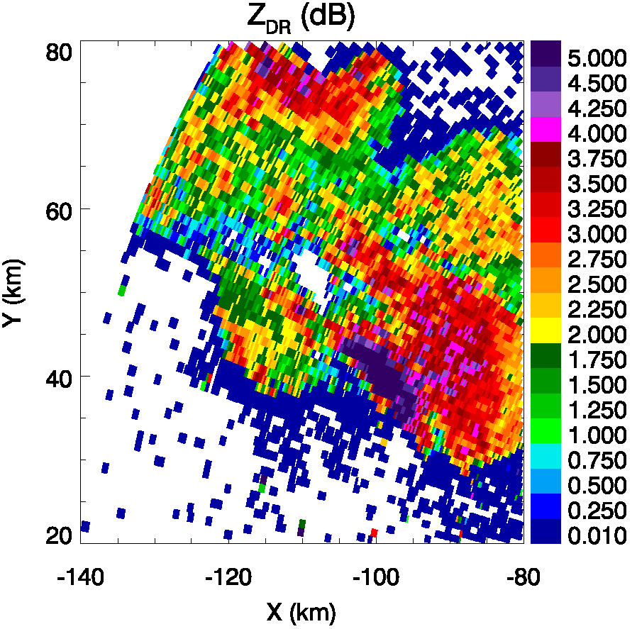
Polarimetric Signatures in Supercell Storms
Recent investigations (Ryzhkov et al. 2005; Kumjian and Ryzhkov 2008,2009) have revealed repetitive polarimetric radar signatures in supercell storms. These signatures are unique to supercells and provide insight into the storm’s evolution and behavior and exemplify links between storm kinematics and microphysics.
One such signature is the low-level Z_{DR} “arc”

Slide 7
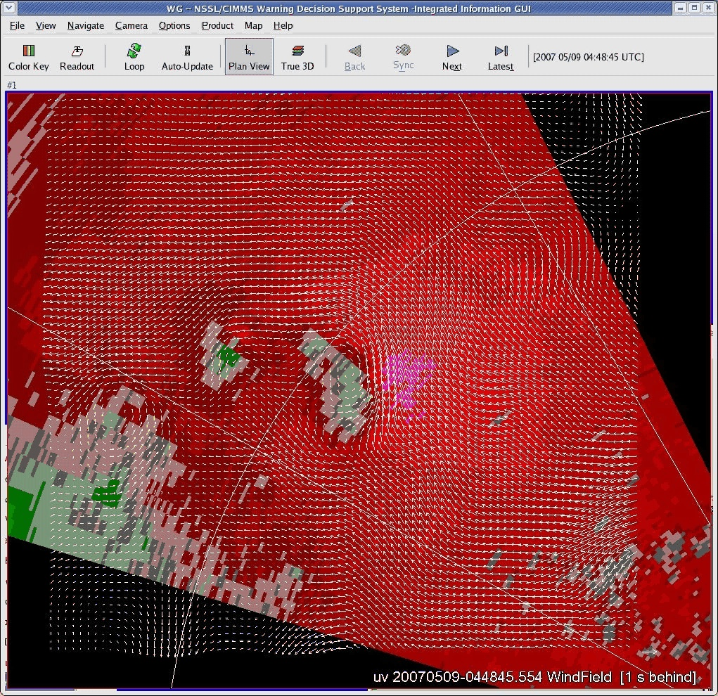
Wind retrieval on conical surface
NWRT 20070509
81x81pts
500mX500m
Moving Frame
U=2m/s
V=11m/s
Phase Array radar
Courtesy of Qin Xu

Slide 8
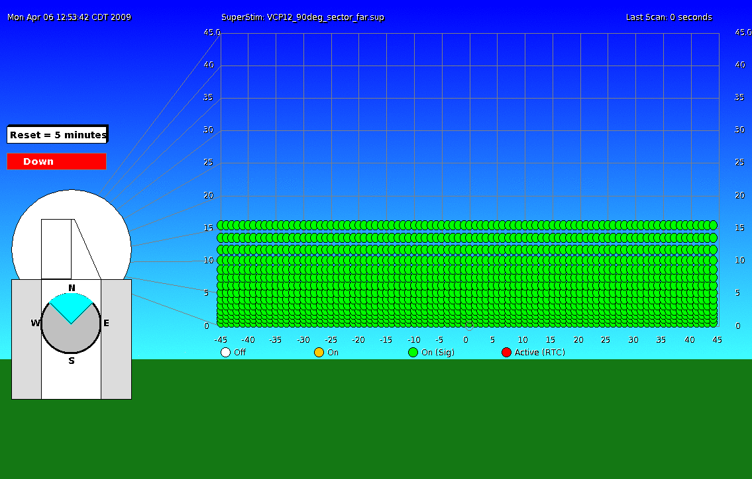
New Adaptive Scanning Capability
8
Notes:
2008 AMS Conference
8

Slide 9
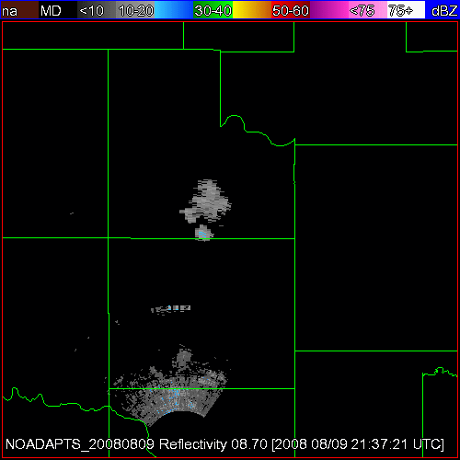
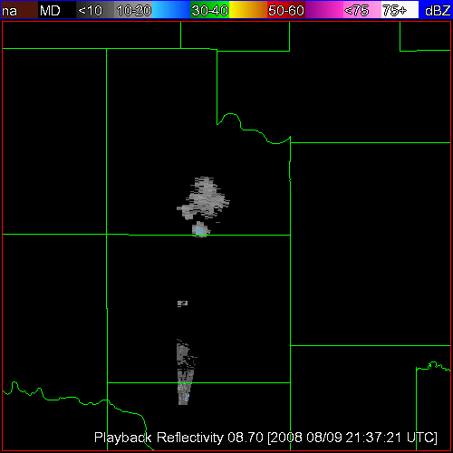
ADAPTS Performance
Qualitative Evaluation
ADAPTS is OFF
ADAPTS is ON
09 AUG 2008 – Reflectivity - 8.7 deg

Slide 10
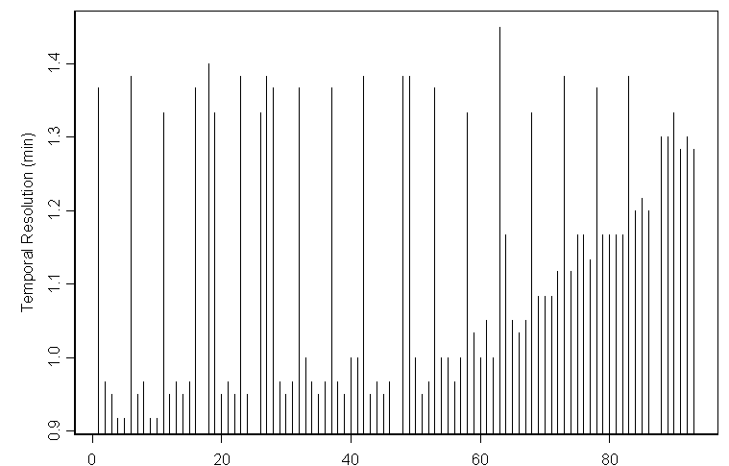
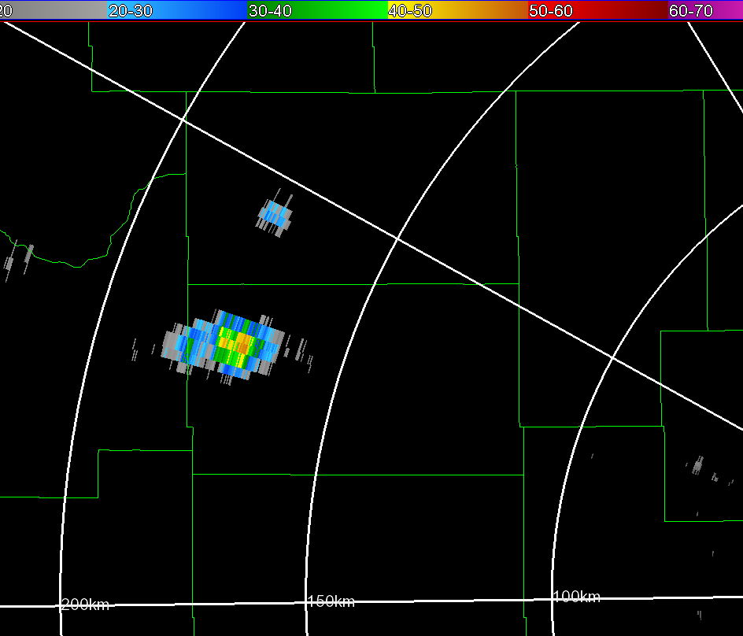
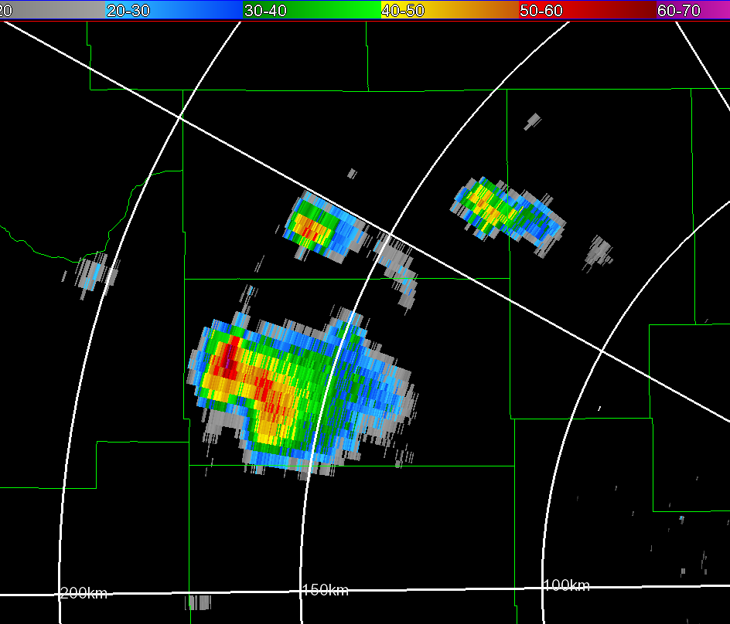
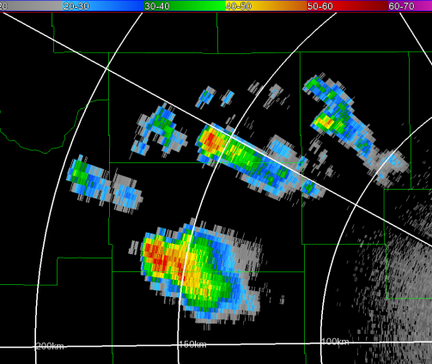
ADAPTS Performance
Quantitative Evaluation
a)
1 May 2009
Nominal Update Time
1.4
Time Savings
1.3
1.2
Temporal Resolution (min)
1.1
1.0
ADAPTS Update Times
0.9
0040:59
0104:35
0129:24
0154:27
0217:27
Time (UTC)
b)
0040:59
0129:24
0217:27
200 km
150 km
100 km
200 km
150 km
100 km
200 km
150 km
100 km
10

Slide 11
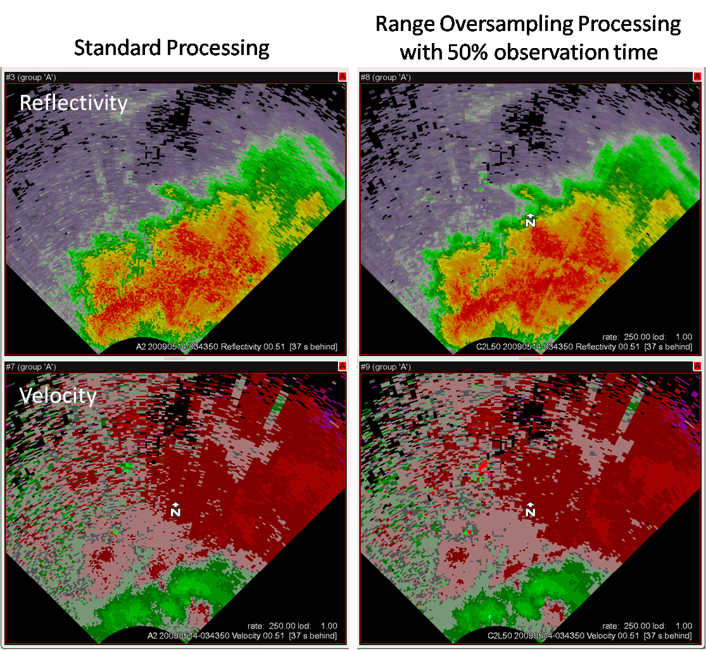
Range Oversampling

Slide 12
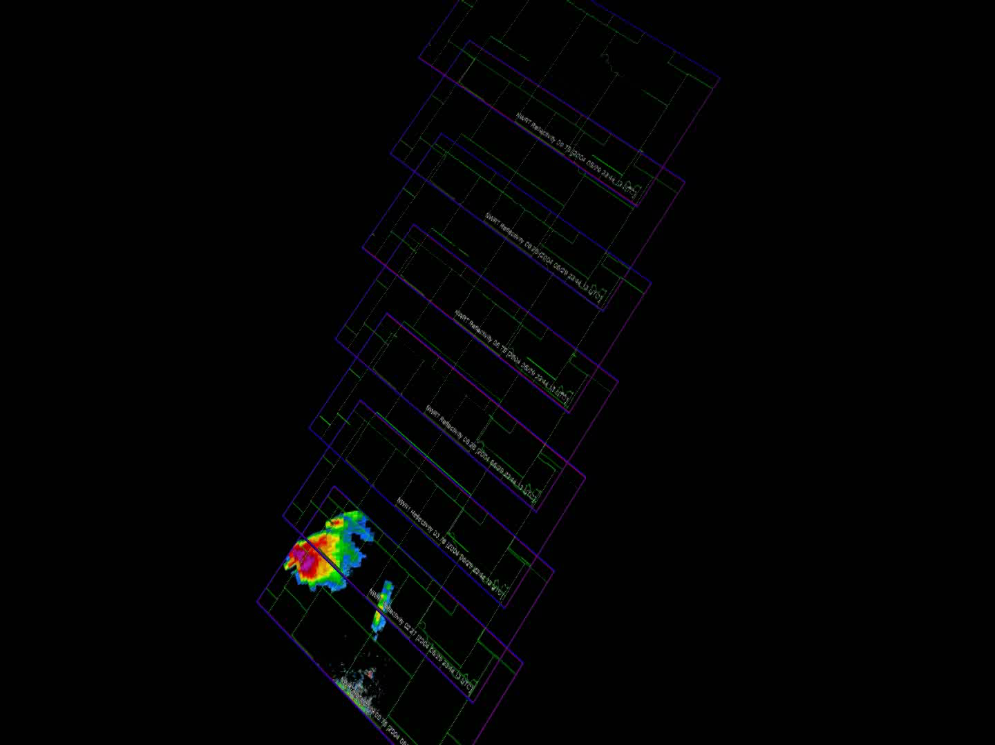

Slide 13
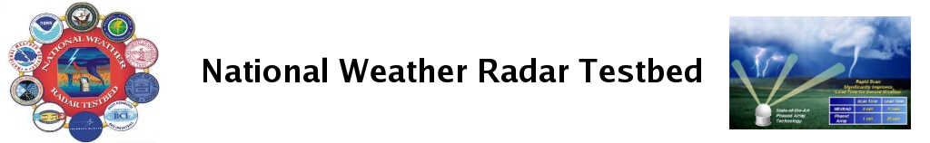
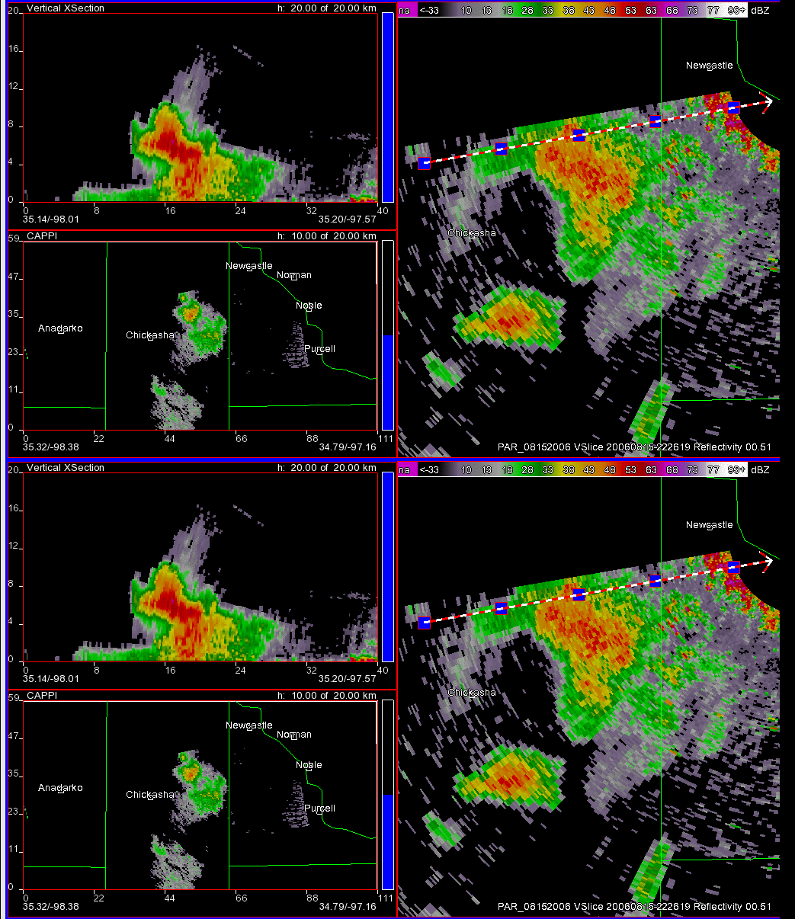
Earlier detection of large hail aloft
223346 UTC
15 August 2006
PAR Reflectivity cross-section, cappi (10 km), and 0.5° PPI
Images ~ 26 s
Simulated WSR-88D Reflectivity cross-section, cappi (10 km), and 0.5° PPI
Images ~ 5 min

Slide 14
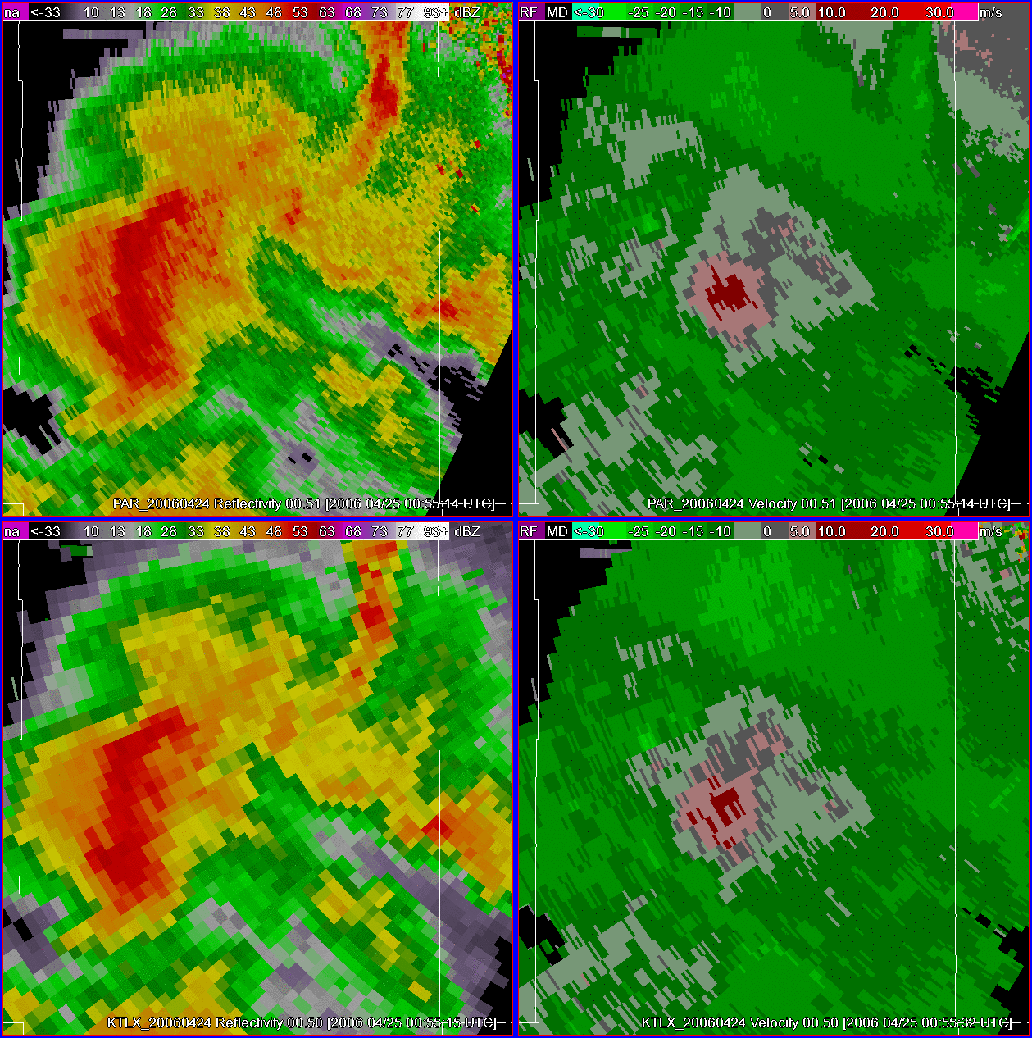
Earlier detection of velocity signatures
223346 UTC
24 April 2006
PAR Reflectivity & Velocity 0.5° PPI
Images ~ 58 s
KTLX Reflectivity & Velocity 0.5° PPI
Images ~ 4 min

Slide 15
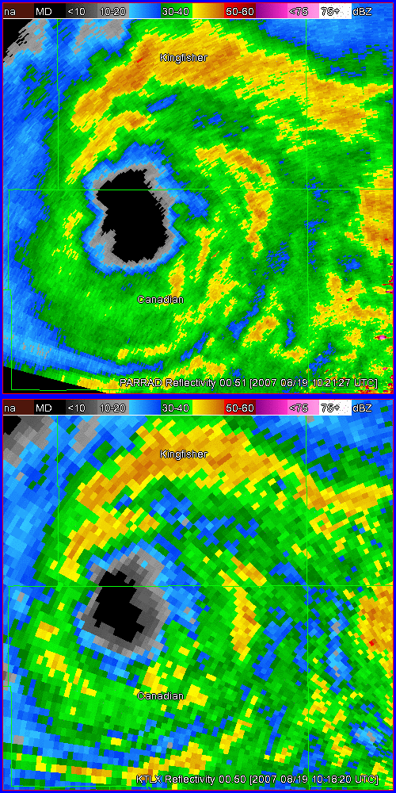
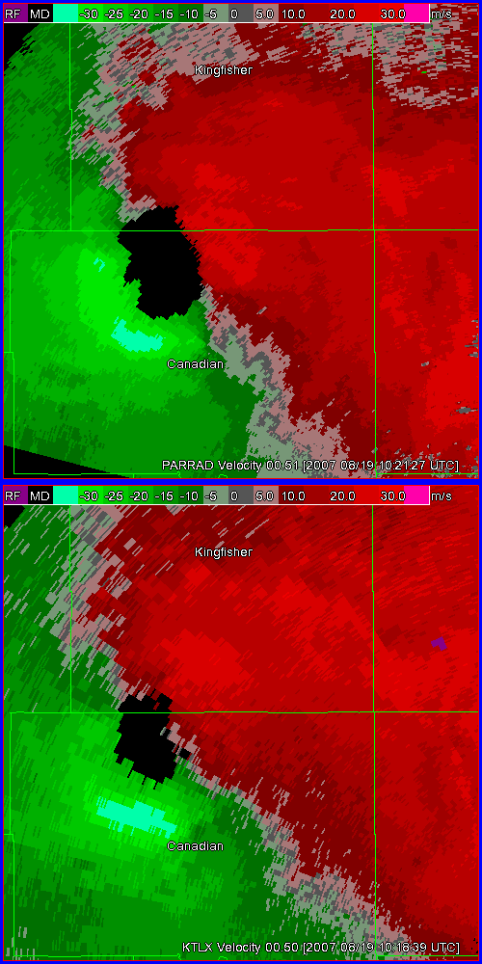
Tropical Storm Erin: Eyewall
19 August 2007
PAR
PAR
PAR VCP 12 BMX 60° sector
0.5° oversampling in azimuth
Images ~ 43 s
KTLX
KTLX
WSR-88D VCP 12 Images ~ 4.1 min

Slide 16
5-10 years
Development of Cost affordable Dual-Polarized Phased Array
Multi-function Phased Arrays
Automated Adaptive Scanning
4-D User Interface between data and Users
Real-time delivery of radar data and warnings to hand-held portable devices, automobiles, airplanes, etc.

Slide 17
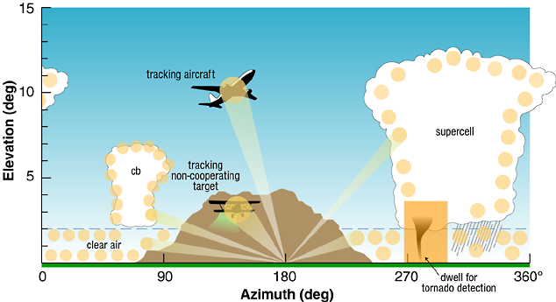
Potential uses of Phased Array Radar

Slide 18
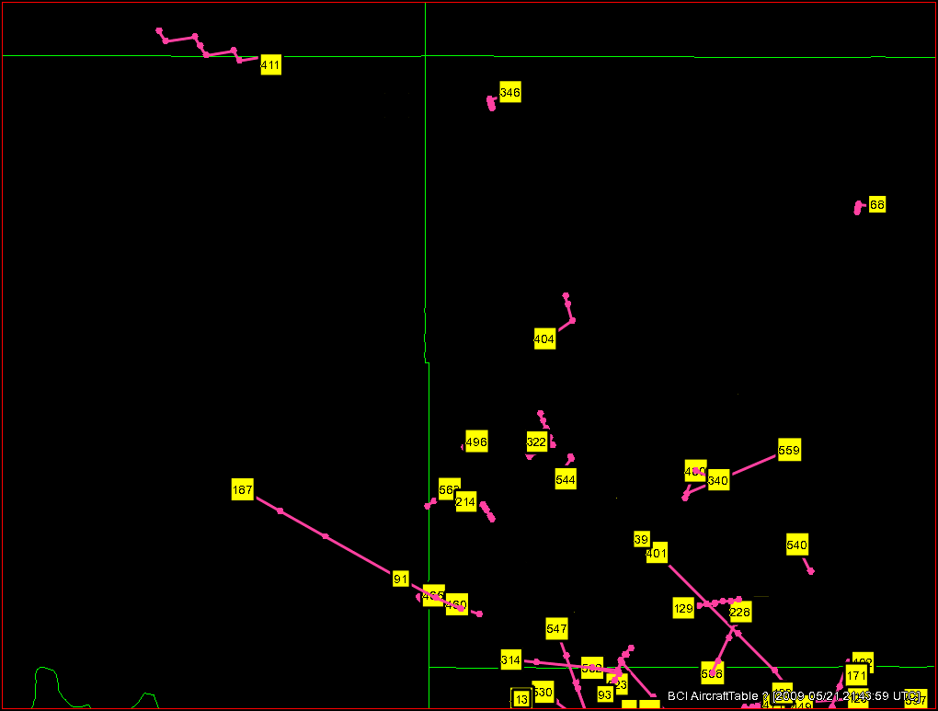
FAA/BCI Aircraft Tracking

Slide 19
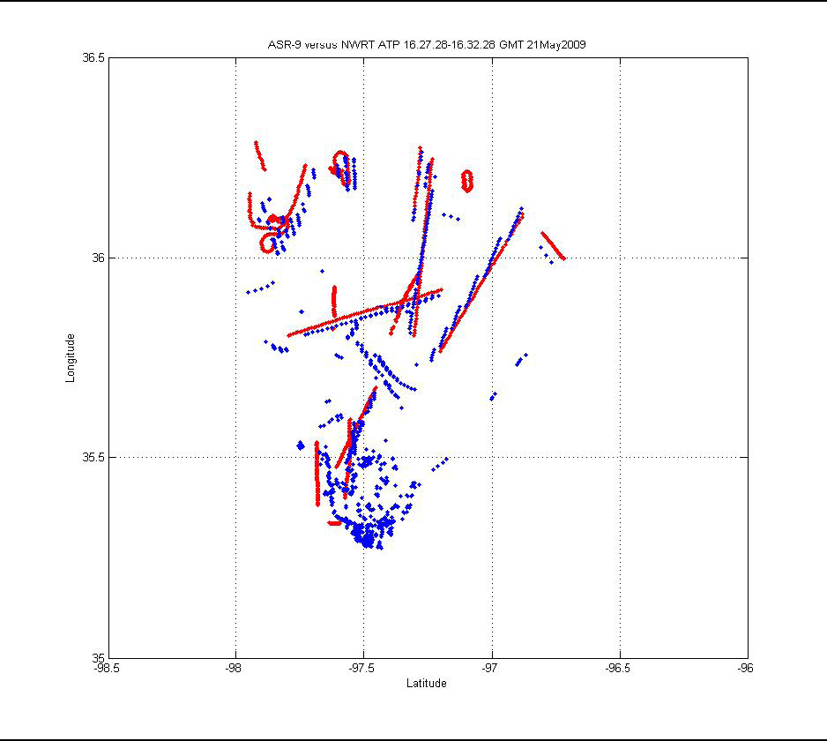
ASR-9 vs. ATP / May 21, 2009 16:27:28 – 16:32:28 GMT
ASR-9
ATP
Courtesy of Basic Commerce Industries

Slide 20
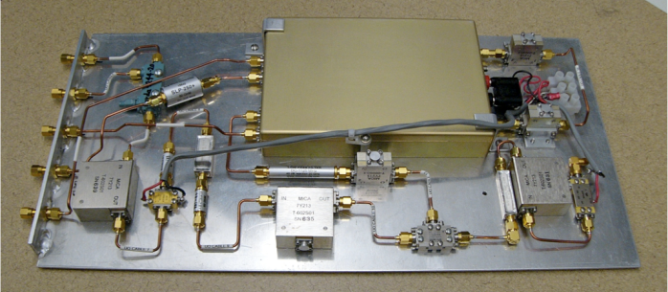
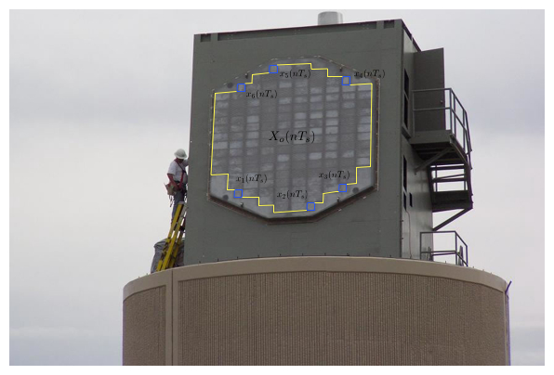
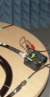
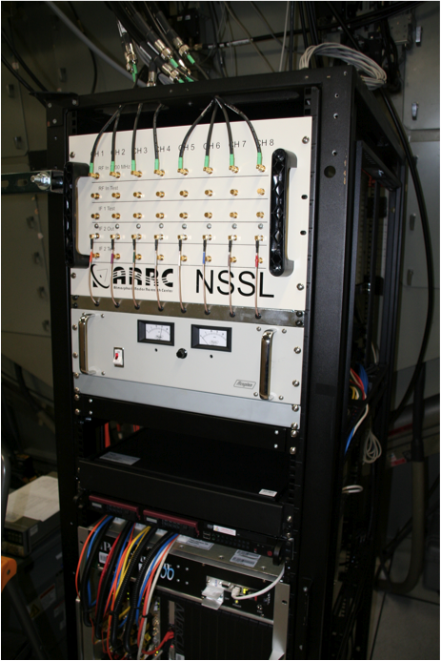
Multi- Receiver System
eight downconverters
eight LNA’s
1 - Az Diff
1 - El Diff
6 – Clutter Channels
Monopulse
Courtesy of Mark Yeary
Installed rack w/ digital receivers

Slide 21
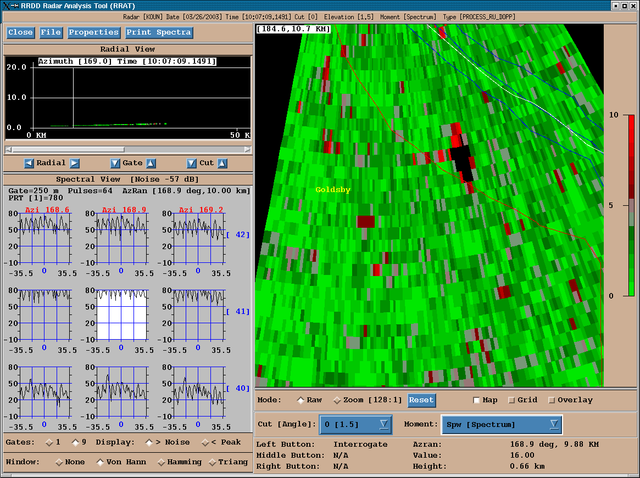
Signature of Airplane

Slide 22
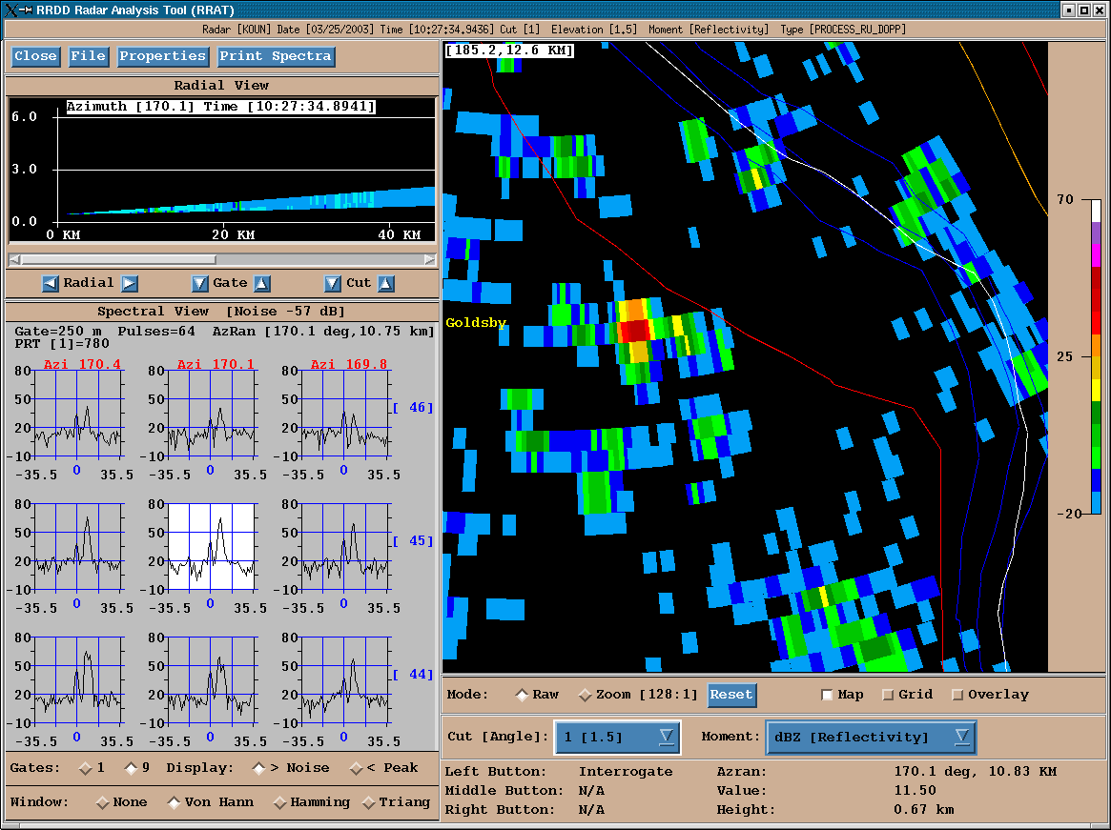
Example of Release

Slide 23
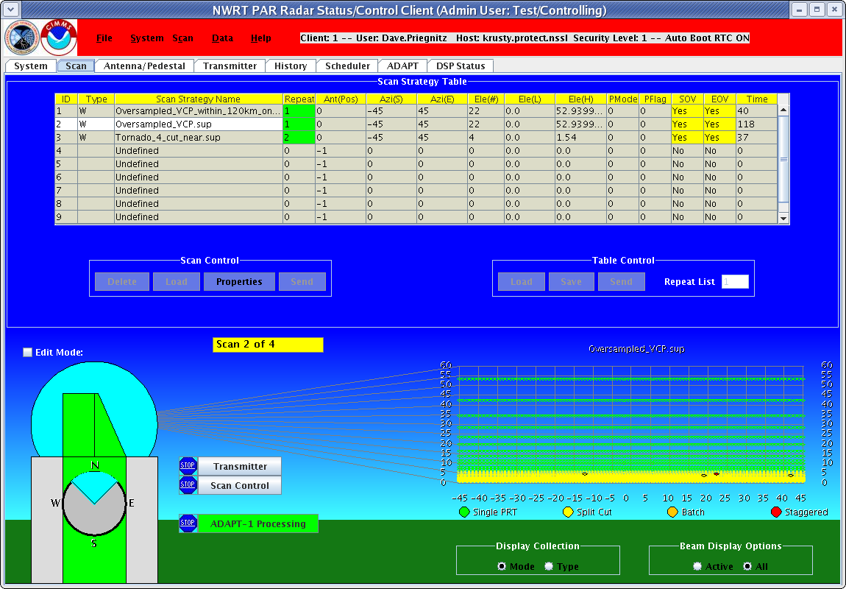
User Interface – Adaptive Scanning

Slide 24

3D Isosurface Display
Animation of reflectivity core
(green) and mesocyclone
vortex (purple)

Slide 25
10-20 years
No Crystal Ball, but
  Technology is still expanding at an exponential rate (faster and smaller)
  Some think that computers will exceed the capacity of the human brain
  Systems will be robotic
  Weather radars (conformal phased arrays) will be available on various mobile vehicles and will uplink information for mutual use
  Warn-on-forecast will be a reality

Slide 26

Warn on Forecast

Slide 27







Questions?
THANK YOU
Questions:

